Slide 1
Introducing “Oslo”
Mathias Andersson
Stefan Nilsson
Peter Nylander

Slide 2
Model driven development
Microsoft codename "Oslo"

Slide 3
What is "Oslo"? Defining terms
"Oslo" refers to a wave of forthcoming Microsoft products and technologies
It's not the code name for a single new product or new release of a product
The "Oslo" technologies as we know of today
A new repository with a visual editor
A new version of Windows Workflow Foundation (WF)
A new process server for WF, BizTalk, and other applications

Slide 4
Where is "Oslo"? A status report
Microsoft says they'll tell us more about "Oslo" later this year
No release dates have yet been announced
The goal today
Describe some of the main problems “Oslo” addresses
Give you a big-picture view of the technology
Don’t be surprised if there are changes before the first “Oslo” release
Some things are sure to change, e.g., screen shots

Slide 5
What is Oslo?
According to Microsoft ”The future of Application Development”
A modeling platform
A tool that helps people define and interact with models in a rich and visual manner
A relational repository that makes models available to both tools and platform components
Roadmap

Slide 6

IT Today Working in a complex world
Business Process
SLA
Service
Activity
Computer
Application
Data Center
Workflow
Notes:
Imagine the business comes to you complaining that a service level agreement isn’t being met. How do you determine where the problem is? First, you’ve got to figure out which application supports this part of the process—not always an easy thing to do.
Once the app is identified, you might first suspect that the problem is in the data center. This means that you’ve got to find the right computer in the right data center, talk to the right person—its admin—and work things out. How easy is this?
If this doesn’t help, the problem might actually be in the app itself. Perhaps the logic of the workflow is wrong—we’ve misunderstood something when we implemented it—and the business analyst who defined this workflow might be able to help. Sadly, she can’t read C#--she defines workflows using Visio—so she can’t really be helpful.
Or maybe, in this brave new service-oriented world, one of the activities in the workflow exposes a service, and there’s a problem with this service. An architect with a global knowledge of our organization’s services might be able to help us here, but again, he’s got his own descriptions of the architecture. He also can’t help.
Does this sound like your world?

Slide 7

Who Cares About What? Different people, different concerns
Business Analyst
IT Pro
Enterprise Architect
Developer
Notes:
Right now, the information needed to solve this problem is fragmented, stored in different ways and accessed by different tools. There usually aren't connections between these information silos, and so it's tough to do things like track a problem or make a change across the entire environment.
Suppose, for example, that this business process changes so that the SLA on this service gets more stringent, or perhaps another business process wants to use this service. How in the world can anybody figure this out? What has to change to make this happen? Today we rely on email or Word documents or human contact—it’s a difficult process.

Slide 8
Improving This Situation
The challenge
Help people in diverse roles work with diverse information across different domains
Make IT simpler, more effective, and less expensive
The “Oslo” approach
Provide a common repository for all of this information
Provide a visual editor for working with repository information
And allow other tools to be used as well

Slide 9
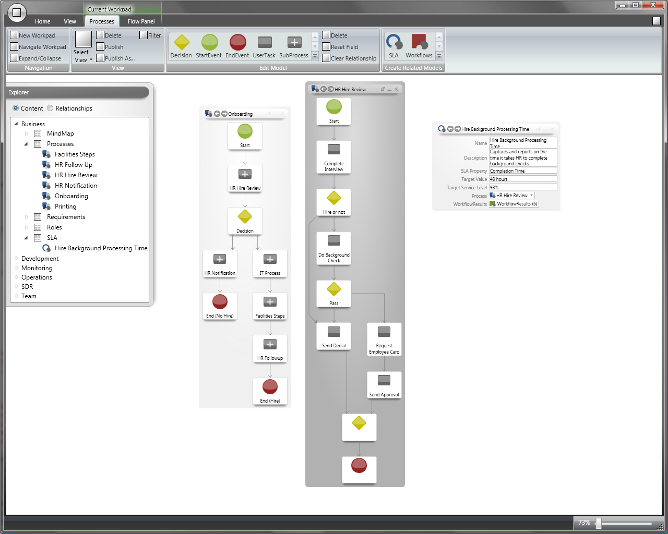
The "Oslo" Visual Editor A closer look
Repository
Notes:
The visual editor lets people create, look at, modify, and delete instances and schemas in the repository.
The editor uses the Office ribbon for all views—the goal was to be easily usable by everybody.
The tool has no built-in schemas. Rather, it’s a generalized editor for schematized data stored in the repository.

Slide 10
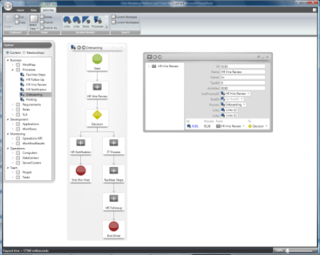
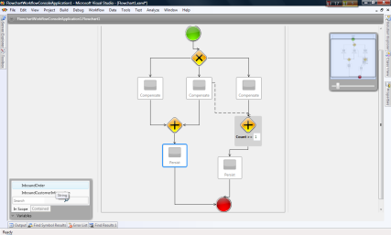
Working Together Different tools for different roles
Business analysts and developers can work together to build WF/WCF applications
Repository
“Oslo” Visual Editor
Visual Studio
Workflow definition as repository instance
Workflow definition as XAML
Business Analyst
Developer
Notes:
This is analogous to how VS and Expression Blend work together via XAML.
A developer is more likely to use Visual Studio—it’s more familiar, the dev is probably doing things that aren’t possible in the visual editor or supported in the repository. Over time, this may change.

Slide 11
What's In The Repository Some examples of pre-defined schemas
Schema
What It Describes
The steps in a process, e.g., a business process
Process
Workflow
A WF workflow
Activity
A specific activity in a WF workflow
A service provided by an application; can run locally or remotely
Service
Application
A (possibly composite) application
Computer
A physical computer
ServiceLevelAgreement
Requirements defined by an SLA
Notes:
Some examples of why this is useful:
An architect new on a project can use all of this to understand the app, why it was designed as it is, how it operates, etc.
I T pros live with a deployed app, and they need to do root cause analysis.
The repository can also contain an endpoint for an external service

Slide 12
Planned "Oslo" Releases
Oslo Wave 1
Oslo Wave 2
Oslo Wave 3
Next version of WF
(will ship with the
.NET Framework “4” and Visual Studio “10”)
Repository
Visual editor
Process server
- WF/WCF host only
Process server
- Lifecycle Manager
- BizTalk host

Slide 13
Resources
Microsoft SOA & Business Process:
http://www.microsoft.com/soa/products/oslo.aspx
Blogs
Douglas Purdy
http://douglaspurdy.com/2008/09/06/what-is-oslo/
Don Box
http://www.pluralsight.com/community/blogs/dbox/archive/2008/09/06/oslo.aspx

